Slide 1
Style Guide for
IMAGINARIUM

Slide 2
Imaginarium
IMAGINARIUM is the online marketplace that helps people find hand-crafted items from real artisans running real, small businesses.

Slide 3
The Logo
IMAGINARIUM
IMAGINARIUM
IMAGINARIUM
IMAGINARIUM

Slide 4
Color Palette
Orange RGB(254, 134, 55) | Gold RGB(208,168,10) | Blue-Gray RGB(44,48,54) | White RGB(255,255,255) | Peach RGB(255,217,206)
Main Accent Earthy Handmade Fun | Main Color Traditional Valuable Happiness | Font Color Easy to Read Not typical black | Textured Paper Background Handmade | Secondary Accent For Orange

Slide 5
Fonts & Typography
CRIMSON TEXT is a font family for book production in the tradition of beautiful oldstyle typefaces.
CRIMSON TEXT SEMI-BOLD is used for our logo in all-caps
Crimson Text Regular is used for the rare Headings that need to stand out
Lato is our primary typeface. It was created with transparency in mind, using classical proportions.
LATO LIGHT is used sparingly as an accent
Lato Regular body text
Lato Black is for Heading 1

Slide 6
Imaginarium
Persona & Challenge Statement

Slide 7
Interview Questions
Key Behaviors, Frustrations and Needs
Why do you use Etsy?
What do you love about Etsy?
What frustrates you about Etsy?
If you could improve something about Etsy, what would it be? Why?
If you could take away something from Etsy, what would it be? Why?
If you could request something be added to Etsy, what would it be? Why?
How do you use Etsy as a customer? (platform)
How do you use Etsy as a vendor? (platform)
Notes:
P1: Buyer Key Behaviors, Frustrations and Needs
Why do you use Etsy? To find gifts for other people
What do you love about Etsy? The fact that most things are handmade and small businesses produce them who are about their customer
What frustrates you about Etsy? Sometimes sellers aren’t professional about what they are selling
If you could improve something about Etsy, what would it be? Why?
- Nothing, it was pretty easy to buy, review and communicate with the seller
If you could take away something from Etsy, what would it be? Why?
- Products that aren’t really handmade or aren’t truly vintage
If you could request something be added to Etsy, what would it be? Why?
- Nothing
How do you use Etsy as a customer? Mobile, Tablet, PC
- On my mobile phone and pc to buy single items at a time, usually for a person that likes handmade items – not for Christmas or birthdays
How do you use Etsy as a vendor?
- I don’t, but if I did I would use it on a PC
P2: Seller Key Behaviors, Frustrations and Needs
Why do you use Etsy? To sell my props and custom gameboards
What do you love about Etsy? Potential market reach
What frustrates you about Etsy? No frustrations yet
If you could improve something about Etsy, what would it be? Why? improve - integration into quickbooks / alt financial software
If you could take away something from Etsy, what would it be? Why?
Nothing
If you could request something be added to Etsy, what would it be? Why?
combine the sell/browse etsy apps
How do you use Etsy as a customer? I don’t
How do you use Etsy as a vendor? On PC to put items up for sale, and mobile to be notified when sales were made

Slide 8
Personas
Buyer Demographics
Seller Demographics
Age: 28
Gender: female
General Income: $24,000
Education: College-Grad
Tech level: High
Job: Administrative Assistant
Early Adopter: No
Skillsets: Creative, Technical
Buyer: yes
Seller: no
Lives in Knoxville
Age: 38
Gender: female
General Income: $45,000
Education: College-grad
Tech level: Mid
Job: Self-employed Etsy seller
Early Adopter: No
Skillsets: Creative
Buyer: yes
Seller: yes
Lives in Nashville

Slide 9
Persona Research: Vendors
https://extfiles.etsy.com/advocacy/Etsy_US_2017_SellerCensus.pdfF
$45,000
Self-employed, sells full time, on her own
College educated
Lives in Nashville
Key Behaviors
Sellers sell as mainly an outlet for creativity, then supplemental income, and third for fun

Slide 10
Persona research: Buyer
66% of traffic was generated through mobile with 50% of sales volume generated from mobile
Makes one purchase day 60%, 40% makes multiple purchases in a day

Slide 11
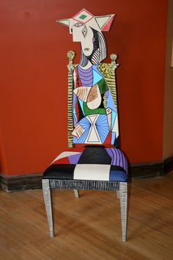
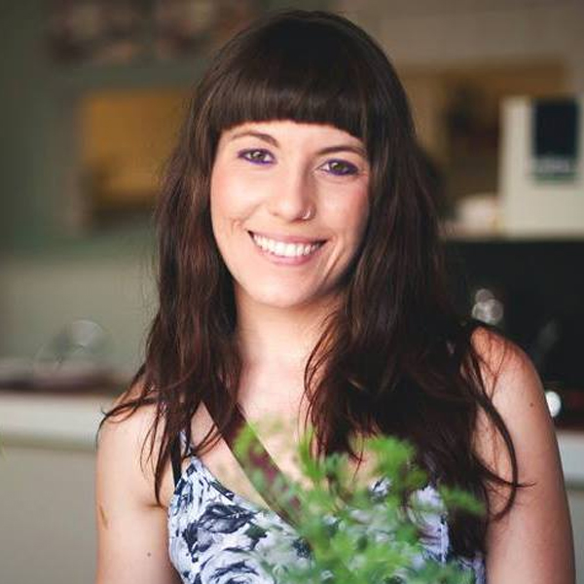
Primary Persona: Gabriella Jardine
Demographics
Age: 38
Gender: female
General Income: $45,000
Education: BA Art Education
Tech level: Mid-High
Job: Self-employed Etsy seller
Early Adopter: No
Skill: Creative
Buyer: no
Seller: yes
Lives in an urban area
Gabriella is an avid painter and up-cycler who found Etsy in 2009 and made it into a full-time gig in 2011. Her most successful seller are her Custom Painted Dining Chairs, which are inspired by Van Gogh, Frida Kahlo, Picasso and more.
Her biggest frustration with Etsy is the separation of the browsing and seller app. She wants to be able to easily see what her buyers are seeing without flipping back and forth between apps.

Slide 12
Challenge Statement
How might artisans of hand-crafted items, who don’t want to be involved in mass retail, market and sell their products to consumers who prefer buying from small businesses without having to sign in to more than one account/app/device?
Notes:
How might hand-crafters easily sell their products to their consumers who prefer buying only from small businesses that aren’t involved in mass retail?
Etsy
Facebook Marketplace
Craigslist
Their own website
How might artisans of hand-crafted items, who don’t want to be involved in mass retail, market and sell their products to consumers who prefer buying from small businesses without having to sign in to more than one account/app/device?
Etsy (more than one app for sellers and buyers)
ArtFire (unknown)
Facebook Marketplace (supports mass retail items)
Craigslist (supports mass retail items)
Their own website (hard to market)
Ebay (supports mass retail businesses)
Amazon (supports mass retail businesses)

